Slide 1
88MPH: Digital tricks to bypass Physical security
ZACON IV (2012)
Andrew MacPherson

Slide 2
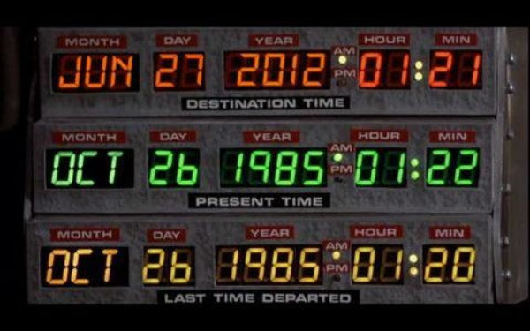
WHO AM I?
Andrew MacPherson (IKR)
B. Information Science(2006)
Paterva
Script Kiddy
Lazy
@AndrewMohawk
www.andrewmohawk.com

Slide 3
Why Physical Security?
Sections
Locks
Guards
RFID
Magstripes
Alarms / Remotes
IT Security is getting a lot better (I hope)
Improves at the speed of Internets
Most people assume if someone can physically get to their stuff they will own it
Pulling out Harddrives / Safe mode / blah
Stealing laptops (ask Dominic / SP)
Protections against people physically getting to your stuff:
Uber slow at improving
Price
Not looked at (anyone know who does physical pentests in South Africa?)
I’m Lazy, other stuff seems far more difficult

Slide 4
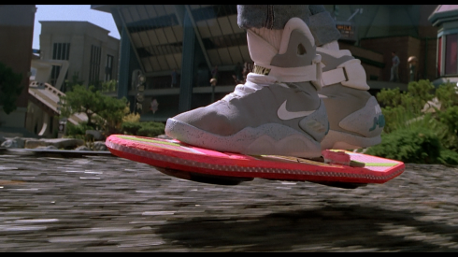
Whats this talk all about?
Locks (quickly –demos after)
RTLSDR - RF (Having a listen, Mhz!)
RFID
LF entry Tags – How they work, cloning
HF Mifare Tags – How they work, modifying
Magstripes – How they work, spoofing, cloning
Alarms / Remotes – RFCat – RF (Having a chat! Hi MOM!)
How they work, spoofing, spamming and jamming.

Slide 5
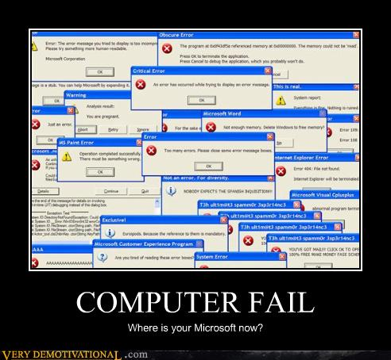

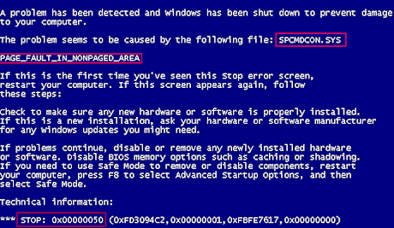

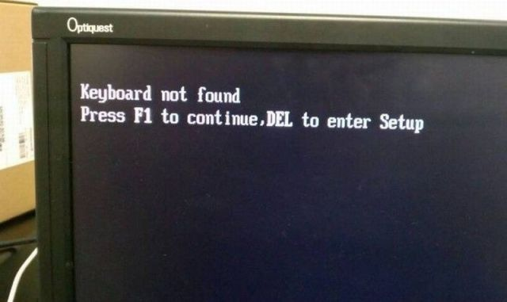

DISCLAIMER
I have demos.
I am not a lawyer, engineer or ham!
Expect half truths!
Some of the RF stuff could be in the “grey” area.

Slide 6
Permissions
?
People Who Gave me Permission
Roelof Temmingh (Paterva)
Sensepost
People Who didn’t / Didn’t reply
University of Pretoria
Standard Bank (Points for effort though – thanks!)
ABSA
Protea Centurion / Pretoria
Interpark (Menlyn)
Centurion Lake Hotel
Bombela (Gautrain)
Centurion Mall
All the res’ on campus
All the local hotel lock companies

Slide 7
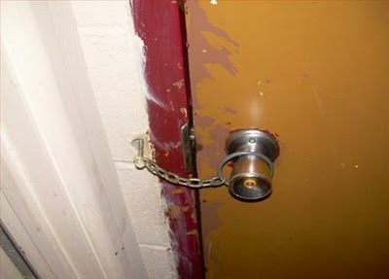
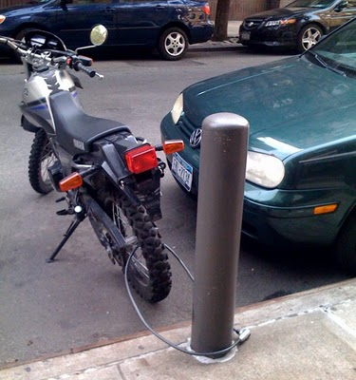
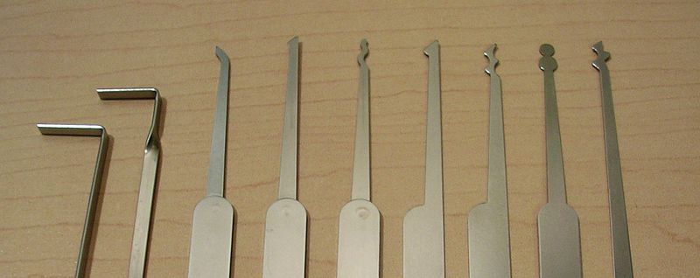

Locks
Often first line of defense
Padlocks / Door locks
For the most part are not that difficult
Often overlooked

Slide 8
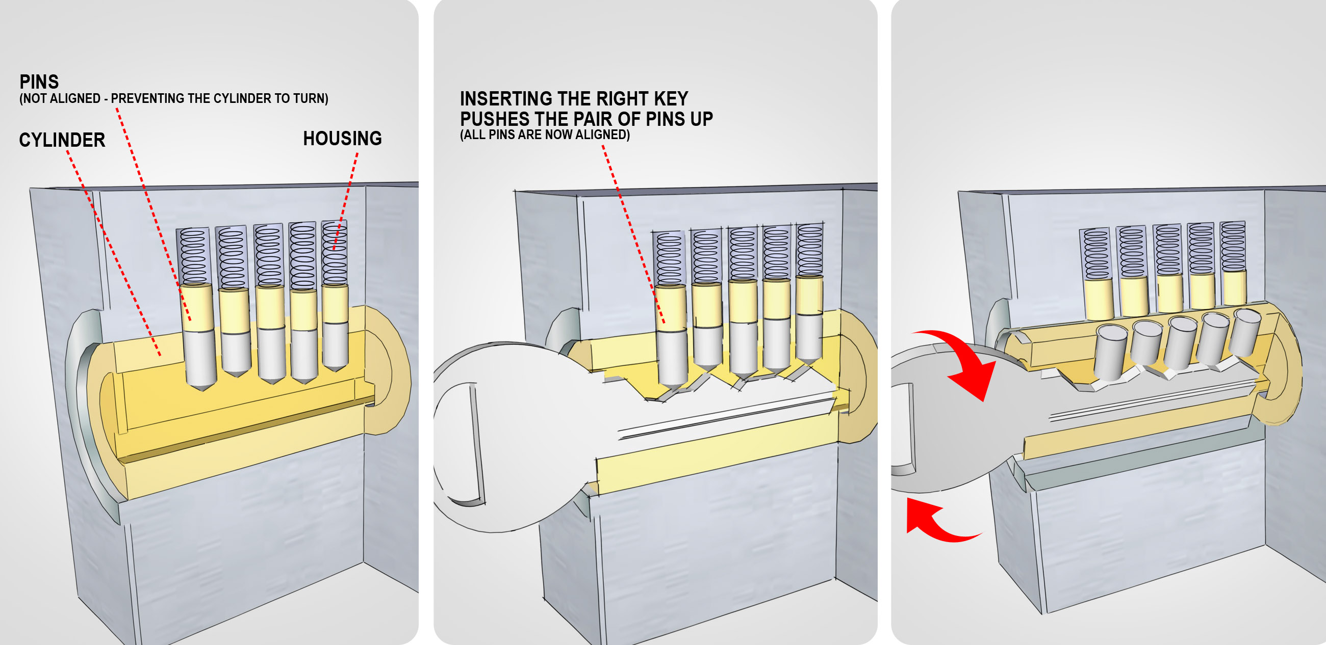
Lockpicking 101
Images from http://www.wikihow.com/Pick-a-Lock

Slide 9
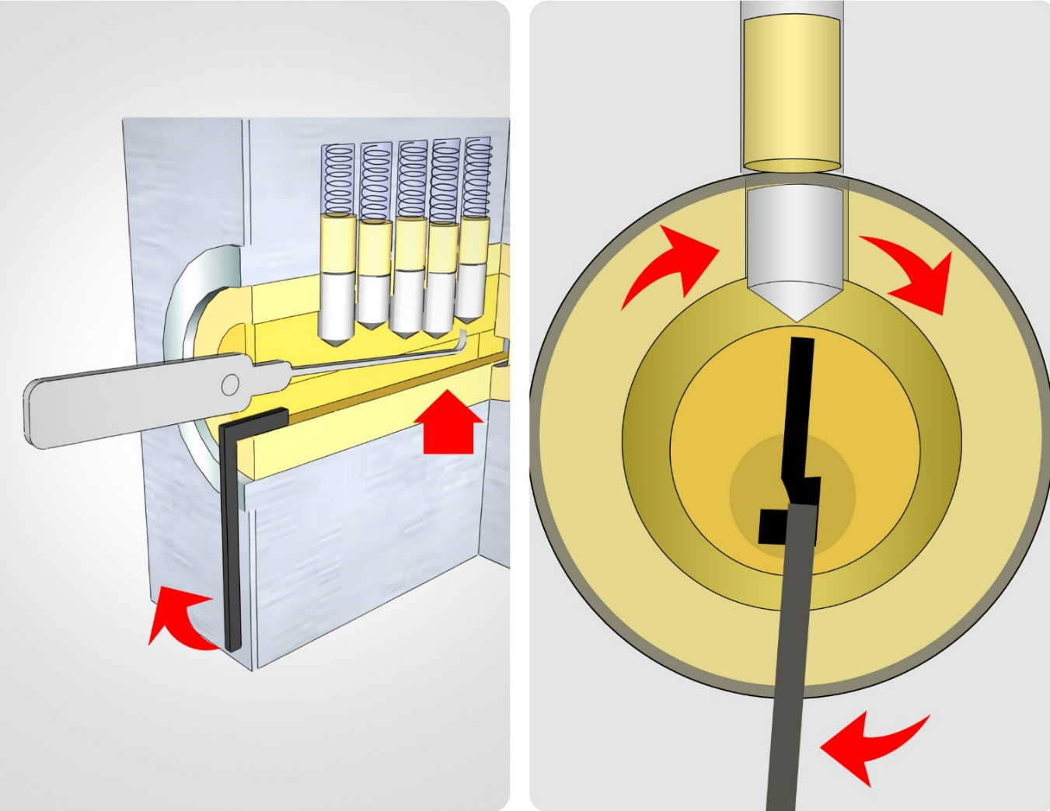
Lockpicking 101
More expensive locks are a not always harder
Better made (pins push easier, lock turns easier)
Counter-measures
Anti-pick pins
Different keys
If you want to use locks, pay for them.
Have picks + locks, afterwards!
Images from http://www.wikihow.com/Pick-a-Lock

Slide 10
LockPicking 101: Demo
DEMO TIEMZ (After talk.)

Slide 11

RTLSDR (Listening to Radio)
RTLSDR - $20 (R160!) Software Defined Radio
http://www.reddit.com/r/RTLSDR
http://rtlsdr.reddit.com
It’s a TV Card!
RTL2832U Chip
E4K Tuner
Primarily devised for listening to radio / watching TV
Doesn’t only do TV/ Radio Freq!
~60mhz – 1500mhz
This is a HUGE space with LOADS of data

Slide 12
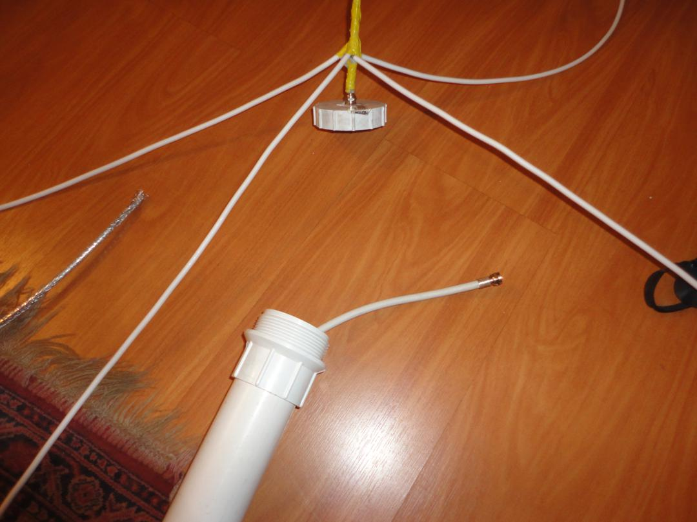
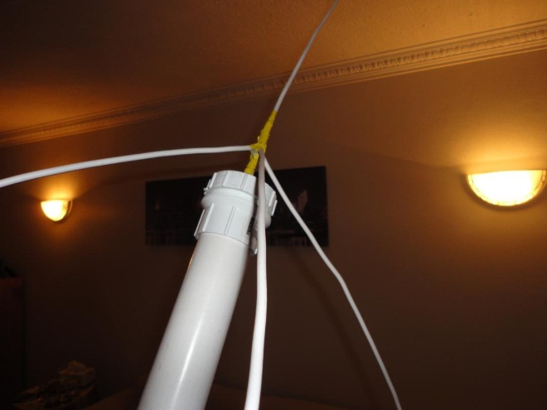
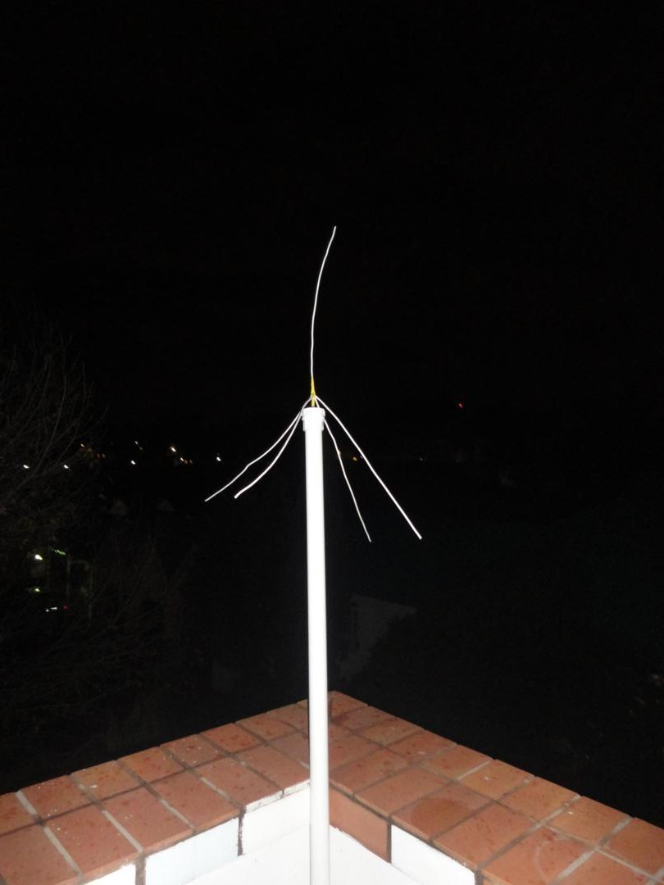
RTLSDR - Antenna
Default Antenna’s
Okay for FM
Not too bad for remotes
RTLSDR has a PAL connector
Good luck finding antenna’s that fit this!
F (think dstv) -> PAL available
Antenna with F are avail. But generally expensive
DIY!
CO-AX (its almost free! Seriously! < R1 / m)
Quarterplane Ground antenna
Planes = (300/Mhz * ¼), so for ~122mhz = 300/122*0.25 = 0.6m

Slide 13
RTLSDR (Listening to the radio)
HDSDR / SDR# / GRC
Windows / Linux (Although my fav is HDSDR on windows)
Easy to install + go
What can we do?
Guard Communications
Tell us WHERE they are as well as WHO they are (names + OB numbers)
Remote codes (later)

Slide 14
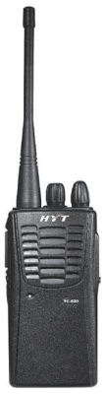
RTLSDR (Listening to 2 ways)
http://www.ohwatch.co.za/radio-network/
“The radios use a dedicated, ICASA assigned, frequency to communicate with all OH WATCH members, South African Police Service (SAPS), City Bowl Armed Response (CBAR) and ADT”
“The radios that the majority of OH Watch radio users have purchased are HYT TC 500”
Common Security Company Frequencies (ask the oracle):
136-150MHz
150-174MHz
350-370MHz
370-390MHz
400-420MHz
450-470MHz
Most radios are using NFM (narrow FM), this is NOT the same as FM

Slide 15

RTLSDR (Listening to 2 ways)
DEMO – Security Guards

Slide 16
RTLSDR (Listening to 2 ways)
What could go wrong?
Security Companies often have to have guards “check in” on locations
I know where they are
Guards often discuss procedures, give away valuable intel on how they operate
I know what they do
Guards receive details on where they need to go if something happens
I know if they are on to me
Coupled with Lockpicking = inside perimeter

Slide 17
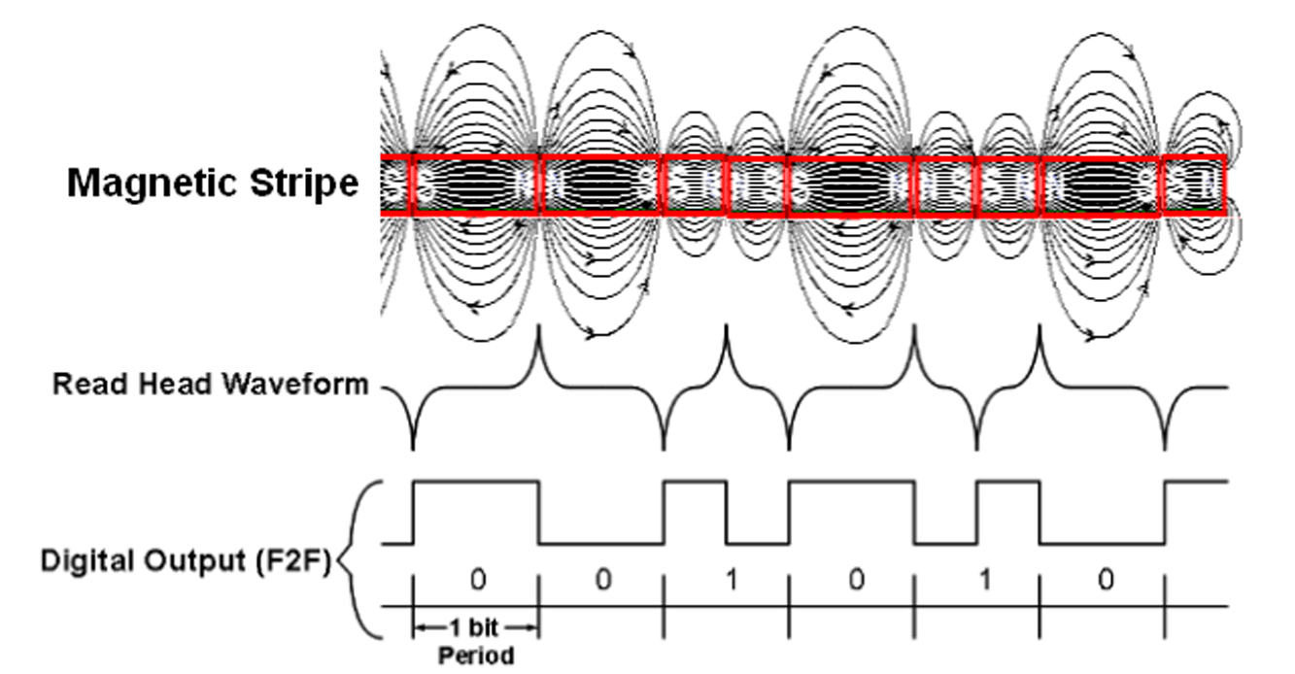
Magstripes: overview
Now we are in the perimeter, getting past the doors
Often places uses magnetic stripes for entry (swipe in)
Same as credit cards, hotels, loyalty cards, telephone cards, gift cards, etc
Magstripes are tapes! Old school!
Think of it as a lot of magnets taped back to back on a strip of paper
Opposite poles repel causing “spikes” in read head
Can literally use a tape read head!

Slide 18
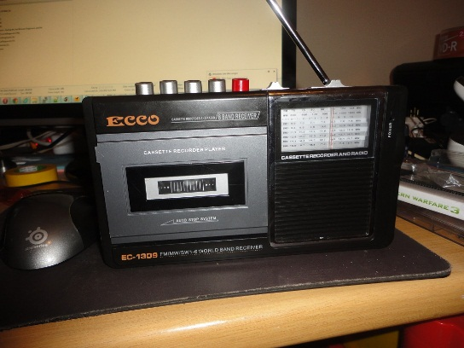
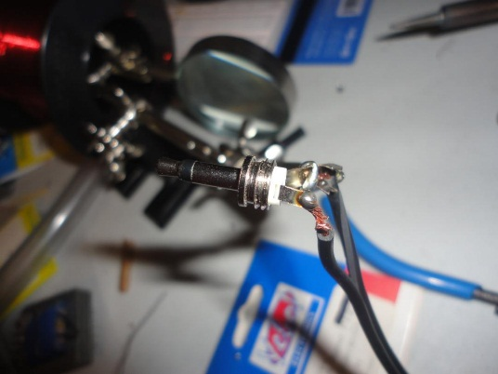
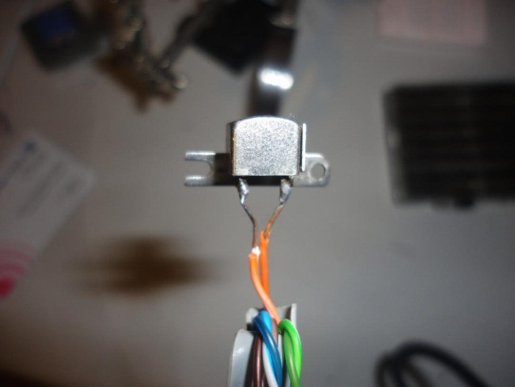
Magstripes: overview
Normal tape head will be able “hear” magnetic stripes
DEMO (listen carefully)
However the tracks are at SPECIFIC heights
IATA = International Air Transport Association
ABA = American banking association
Thrift = Thrift savings industry
0.223″ | Track | Density (BPI) | Character Configuration (including parity) | Content
0.110” | IATA | 210 | 7 bits (6+1) | 79 alpha
0.110” | ABA | 210 | 5 bits (4+1) | 40 numeric
0.110” | Thrift | 210 | 5 bits (4+1) | 107 numeric

Slide 19
Magstripes: reading
USB HID devices most common (found in general stores)
Not everything fits common formats (although usually at right “heights”):
Hotel rooms
Door access
Want RAW audio for that, modify TTL readers – R120!
Can only record 1 track at a time :(
Nice for replaying (next)
DEMO: Reading WAV + decode

Slide 20

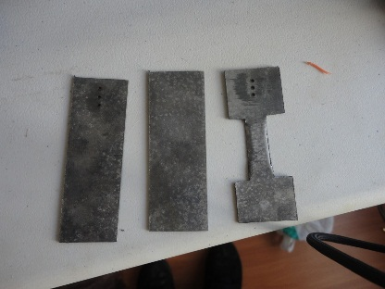
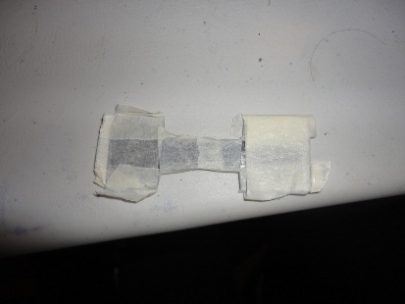
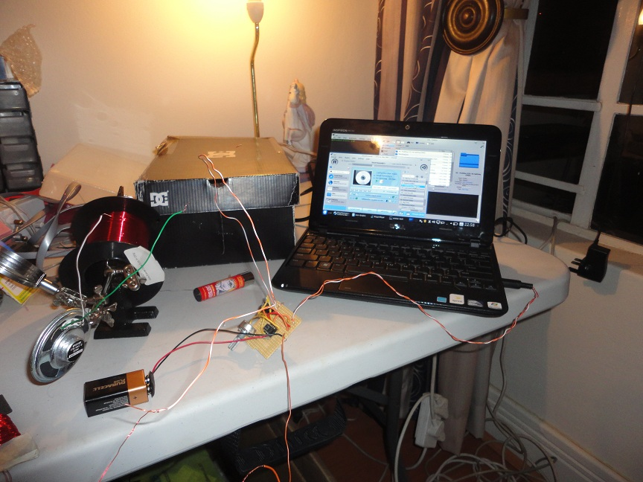
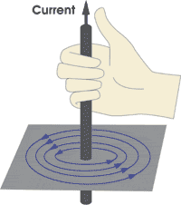
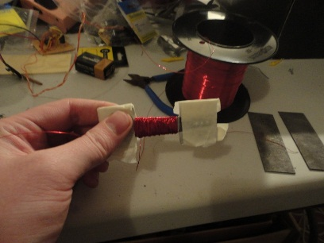
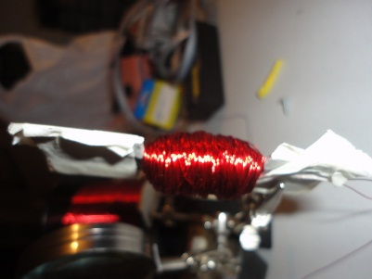
Magstripes: Spoofing
Its those rule! (flemmings) ->

Slide 21
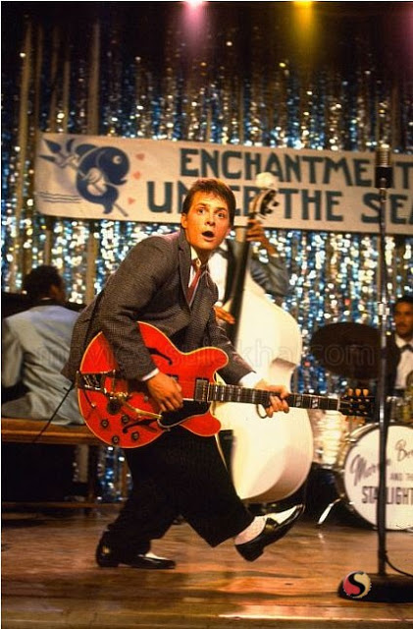
Magstripes: Spoofing
Electromagnetic simulates card moving past read heads
The same as headphones, instead of noise we give out magnetic pulses!
Some readers have a delay (my USB HID = 1second), makes brute force tricky!

Slide 22
Magstripes: Spoofing
DEMO:
Spoofing Magnetic stripes + Brute Force
Magstripes = Inside the building!

Slide 23

Magstripes: Cloaning Done Easy
MSR605 - $80 :S
Windows App, clone/make cards in seconds
DEMO: Cloning card with MSR605 (if we have time)
Magstripes = Inside the building!

Slide 24

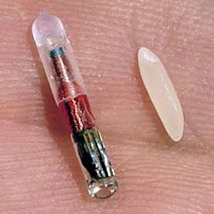
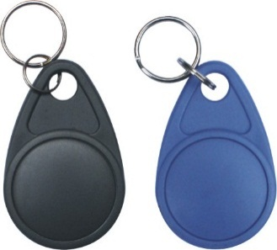
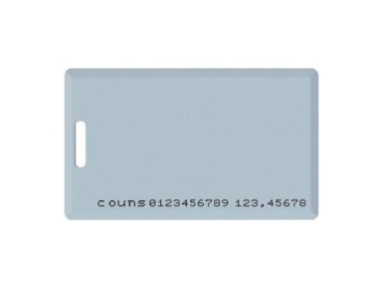
RFID 101
RFID = Radio Frequencey Identification
Its those things you touch against the other things to open the door.
Two common flavours
125 Khz / 134 Khz AKA Low Frequency (LF) tags (most used for access control)
13.56 Mhz AKA High Frequency (HF) tags
Passive vs Active
Generally either in FOB / Card form:

Slide 25
RFID 101: LF Tags
Low frequency tags are often seen as “dumb” tags
Usually 125Khz or 134Khz
Usually Powered by electromagnetic fields used to read them (readers)
Think wireless battery
Once powered + Receive “shout” command
Scream out their tag number (usually its also WRITTEN on the tag)
Short distance (<10cm)
Commonly found are EM41xx tags
ASK + Manchester

Slide 26
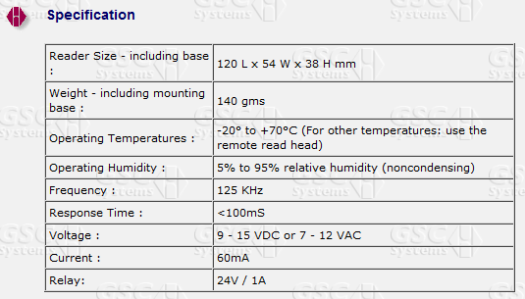
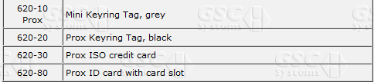

RFID:Discovery
Ask the Oracle :)
Enter Proxmark3
www.proxmark.org
Supports LF/HF tags, many decoding options etc
Figuring out what kind of RFID these are?
hw tune!

Slide 27
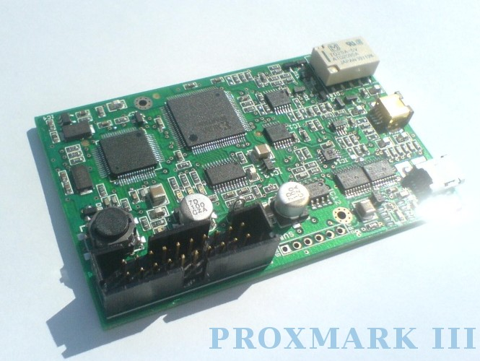
RFID: Discovery
125Khz FOBs
Now what?
Sample data, view on graph
I already know its ASK + Manchester
Double check anyway
Binary?
Look for repeating pattern
Try isolate bits down, diff both tags

Slide 28
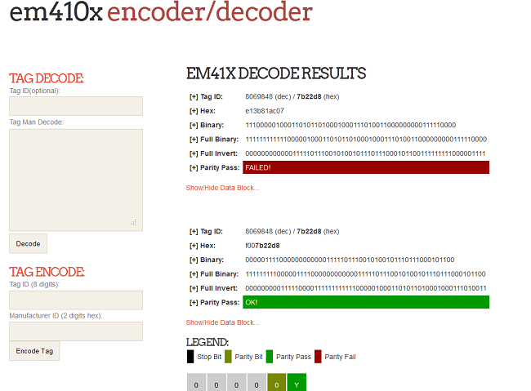
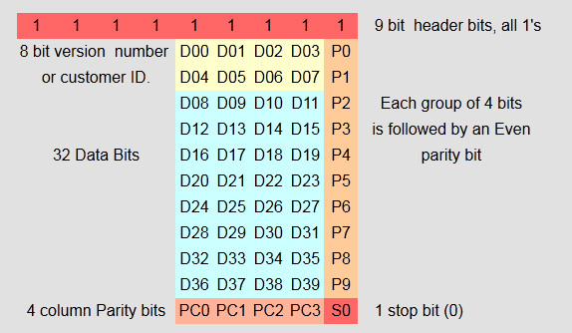
RFID: EM4102
EM41xx Format!
Data works out to the tags!
DEMO: Decoding / Encoding EM410x Tags

Slide 29
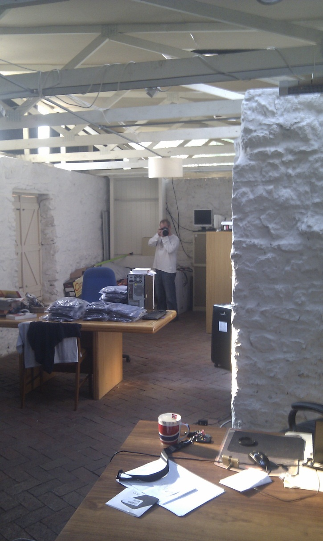
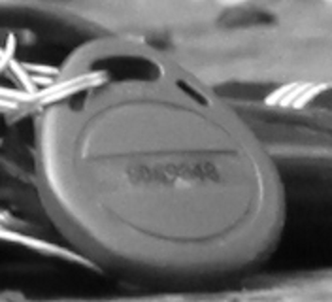
RFID: Spoofing
Now we know format and how the data is structured!
Doing it the easy way – proxmark
Lf em4x em41xread
Lf em4x em41xwatch
Lf em4x em41xsim
Opening doors:
Cloning (em41xsim)
Brute force? 32 bits, ouch. 2^32 = 4294967296
Keyspace really that large?
Sequential tags
Commonality (mine both started with 80!)
Master Keys? How do the locks work?
RTE! Green+White!
Picture it! (zoom lense much?) DEMO: Encoding Tag

Slide 30
RFID: Spoofing
DEMOs:
Opening Normal RFID Lock
Opening Real World RFID Lock (Video)

Slide 31
RFID: HF (mifare)
13.56 Mhz, often considered “smart” tags
Used for payment systems
Transportation systems – like the Gautrain ;)
Data changes!
Mifare classic (1K / 4K)
Mifare broken in 2007/2008/2009 (ask Wikipedia)
Cheap Hardware (R100 reader! – Tikitag/touchatag)
Anything supported by libnfc will work

Slide 32
RFID: HF (mifare)
Think of the cards as 40x256 byte flash drives taped back to back
Each “flash drive” has 2 passwords (Key A and Key B, usually R and R/W )
Keys are 6 bytes.
“flash drive” / sector 0 is NOT changeable and contains UID
Passwords for this are 0x000000 and 0xFFFFFF – wut?
eBay specials can be purchased which allow changing sector 0!!
Entry systems usually simply work on UID, ebay cards = winners!

Slide 33
RFID: HF (mifare)
MFOC
Simple tool for Mifare Offline Cracking (away from where you bought the card)
Issue in Parity sent in the clear!
On the “anonymous” cards I have here, takes around 45 mins to crack a card
After cracking left with hexdump – now what?
Common formats found throughout the internets on what data is contained on these cards

Slide 34
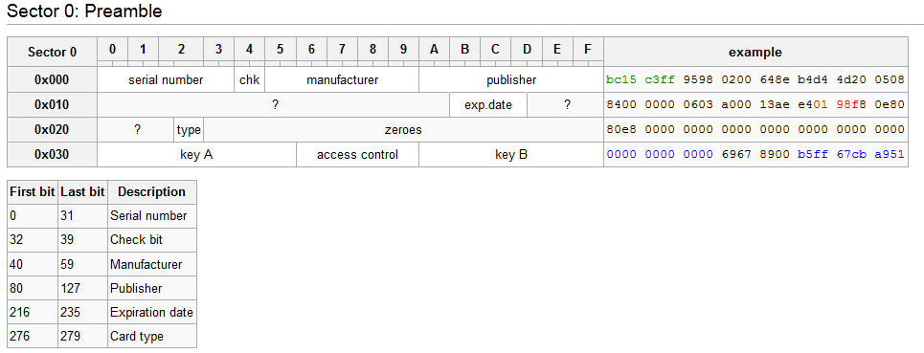
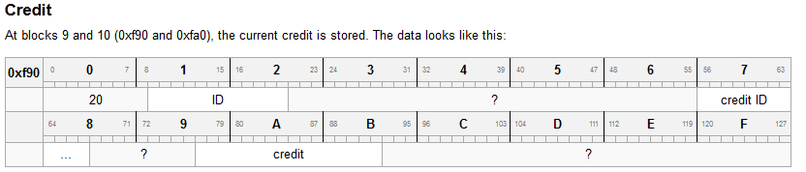
RFID: HF (mifare)
Formats are great!
http://ov-chipkaart.pc-active.nl/Sectors
Cheaper to implement someone else’s system

Slide 35
RFID: HF (Mifare) - My Anonymous Cards
Support transactions, support credit, you pay for them
Fields are VERY similar to the OV-Chipkaart anonymous format
Anonymous format = buy + use
ID format = buy for specific period (such as a month)
Both mine and OVC have 2 money formats (check in + check out)
DEMO: Reading data from cards

Slide 36
RFID: HF (Mifare) – Changing Data
Changing data = uber simple
Hex Edit + Libnfc + write
DEMO: Change data, Read changed data, Write to card!

Slide 37
RFCAT: Having a chat! (HIMOM)
RFCat - Blackhat 2011 workshop
Easily my favourite talk there!
CC1111EMK USB (although it is around $50-$60)
Supports <Ghz range for TRANSMISSION!
Interactive Python, nice for debugging
Coupled with HDSDR = win
HDSDR+RTLSDR for RX RFCat for TX

Slide 38
RFCAT: Having a chat! (HIMOM)
Remotes of all kinds are great!
Usually sit at 403Mhz or 433Mhz
Cars, Garages, Gates
Can listen with RTLSDR + HDSDR
DEMO: Remotes + Recording
Two kinds:
Static keys, Rolling codes (almost always keeloq)
Rolling codes = both parties encrypt data with known key
Static keys = fixed data, sent the whole time

Slide 39
RFCAT: Having a chat! (HIMOM)
Static keys simply repeat signal, nice to find!
Most use ASK/PWM + OOK
Google will tell you when in doubt :)
Recorded audio needs to be replayed to open/close things!
But unlike magstripes we need to give our transmitter *digital data*
Decoding PWM/OOK
DEMO: getting code out!

Slide 40
RFCAT: Having a chat! (HIMOM)
Transmitting Data:
Record from HDSDR
Decode using Python / By Hand
Get Frequency right (use HDSDR to confirm)
Set params for RFCAT
Profit.
DEMO: Opening Remote’d Device (has relay)
DEMO: Opening Real world Garage/Gate

Slide 41
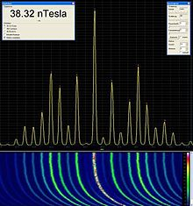
RFCAt: Screaming / Jamming
Decoding data works well with a clean sample
What happens when we start transmitting while your gate/garage/car tries to decode that?
Think of it as two people screaming, if one screams a LOT louder it will still work
DEMO: Jamming Car Signal
Audi / Volvo / VW: Spread Spectrum
Jamming only works if you cover the ENTIRE range
We can jam with RFCAT, but what about RFID?
IT’S THE SAME MOM!

Slide 42
Conclusion
With relatively cheap tech people can:
Listen to people protecting you physically
Pick your locks
Open your garages
Brute force your magstripes
Open your LF locks from pictures
Lock you out/in your building/car/gate with Jamming!

Slide 43
Conclusion
Fixes:
Better Locks
Spread Spectrum for car/gate/etc
Encrypted Guard freq / Education on listening
MONITOR for Jamming
MONITOR magstripe entrances
MONITOR entry attempts

Slide 44
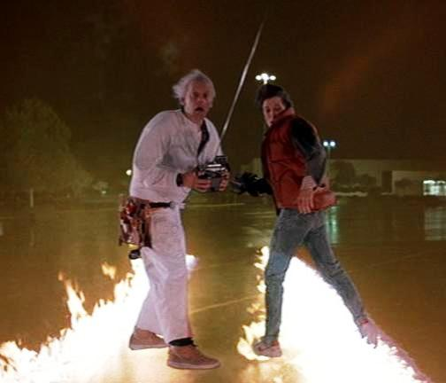
Thanks!
Roelof
Adam (Major Malfunction) + Zac (Apature Labs)
Nadeem Douba
Rogan, RC1140, Rurapenthe Singe, Todor all of IRC
SensePost
At1as (Rfcat)

