Slide 1

Badger Badger Badger
Mushroom mushroom
A talk about the zacon badges 2013
OR
How much Andrew hates cheap GLCDs
OR
Why battery life is important

Slide 2
WHOAMI
Andrew MacPherson (@AndrewMohawk)
Information Science degree from Tuks
Work at Paterva with Roelof Temmingh
  Make Tea
  Write Emails
  Sometimes code
Free time I dabble in things:
  Arduino, Security, blah blah
Skillz?
  <rc1140> i get worried when you work with things that can melt holes in most things

Slide 3
Overview
2 Part Talk:
How the badges were built
How the badges work

Slide 4
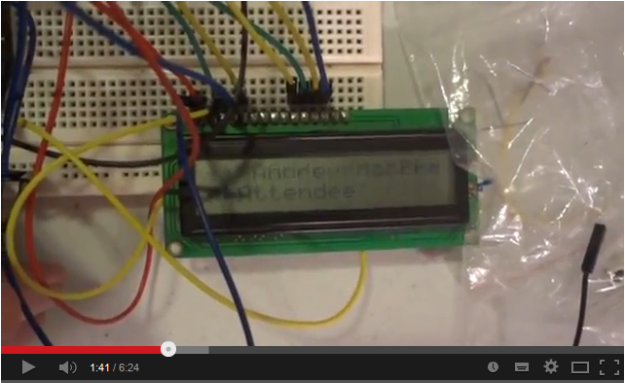
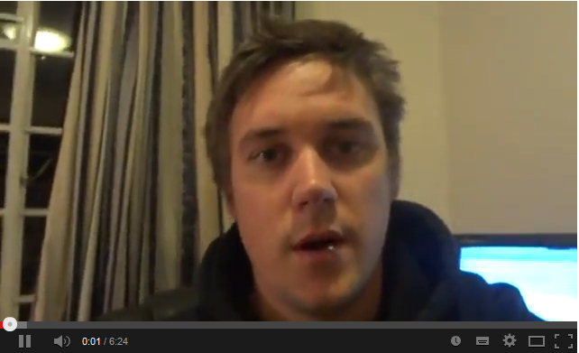
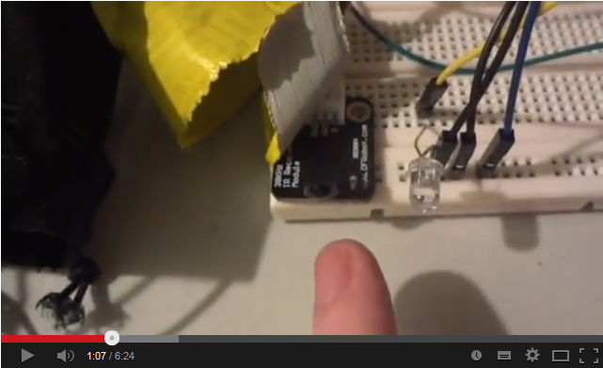
The Idea
Heroes
Joe Grand
Adam Laurie
Mike Ossman
How Many attempts?
3. Last 3 years, all breadboards with epic fail videos

Slide 5
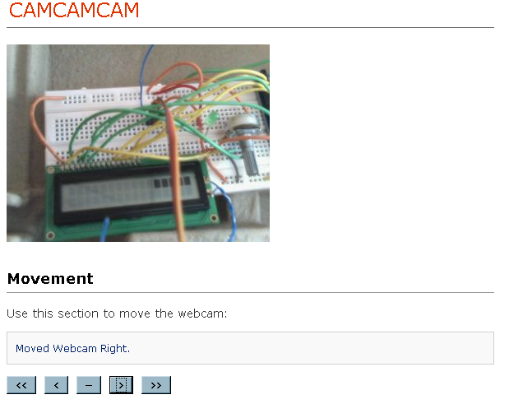
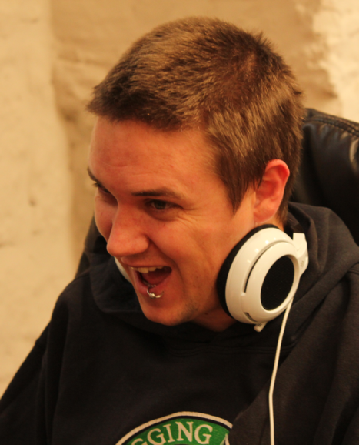
The Idea
Badges that communicate to each other (HI MOM!)
  And in a way see who speaks to who
Badges that provide some use/function (schedule)
Badges that can be hacked (Arduino/customizing WHOAMI)
On the cheap (relative)!

Slide 6
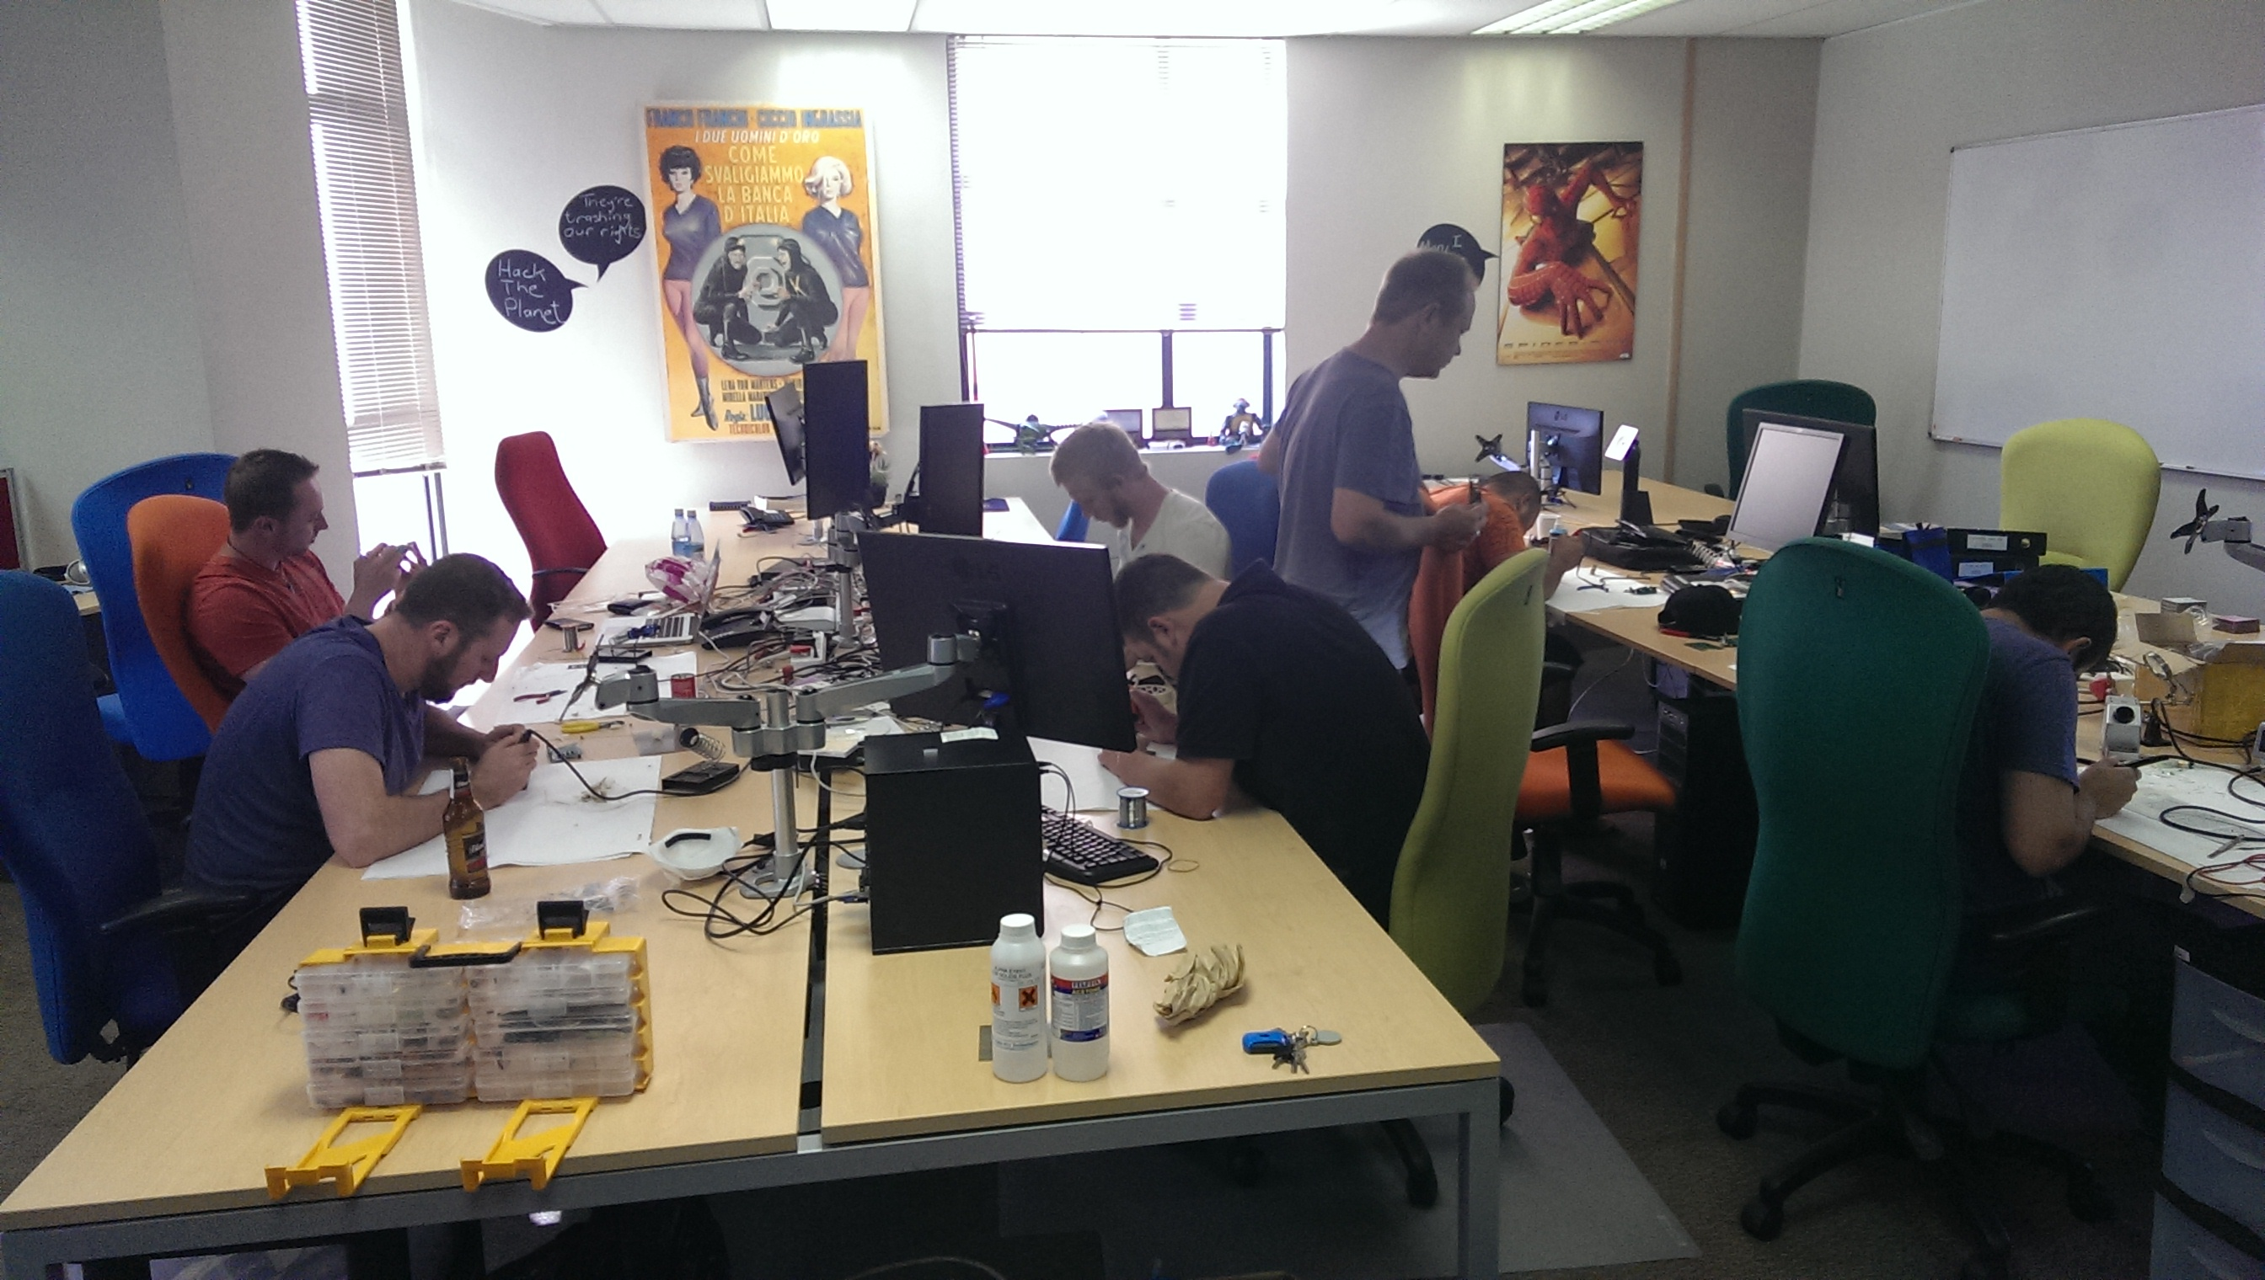
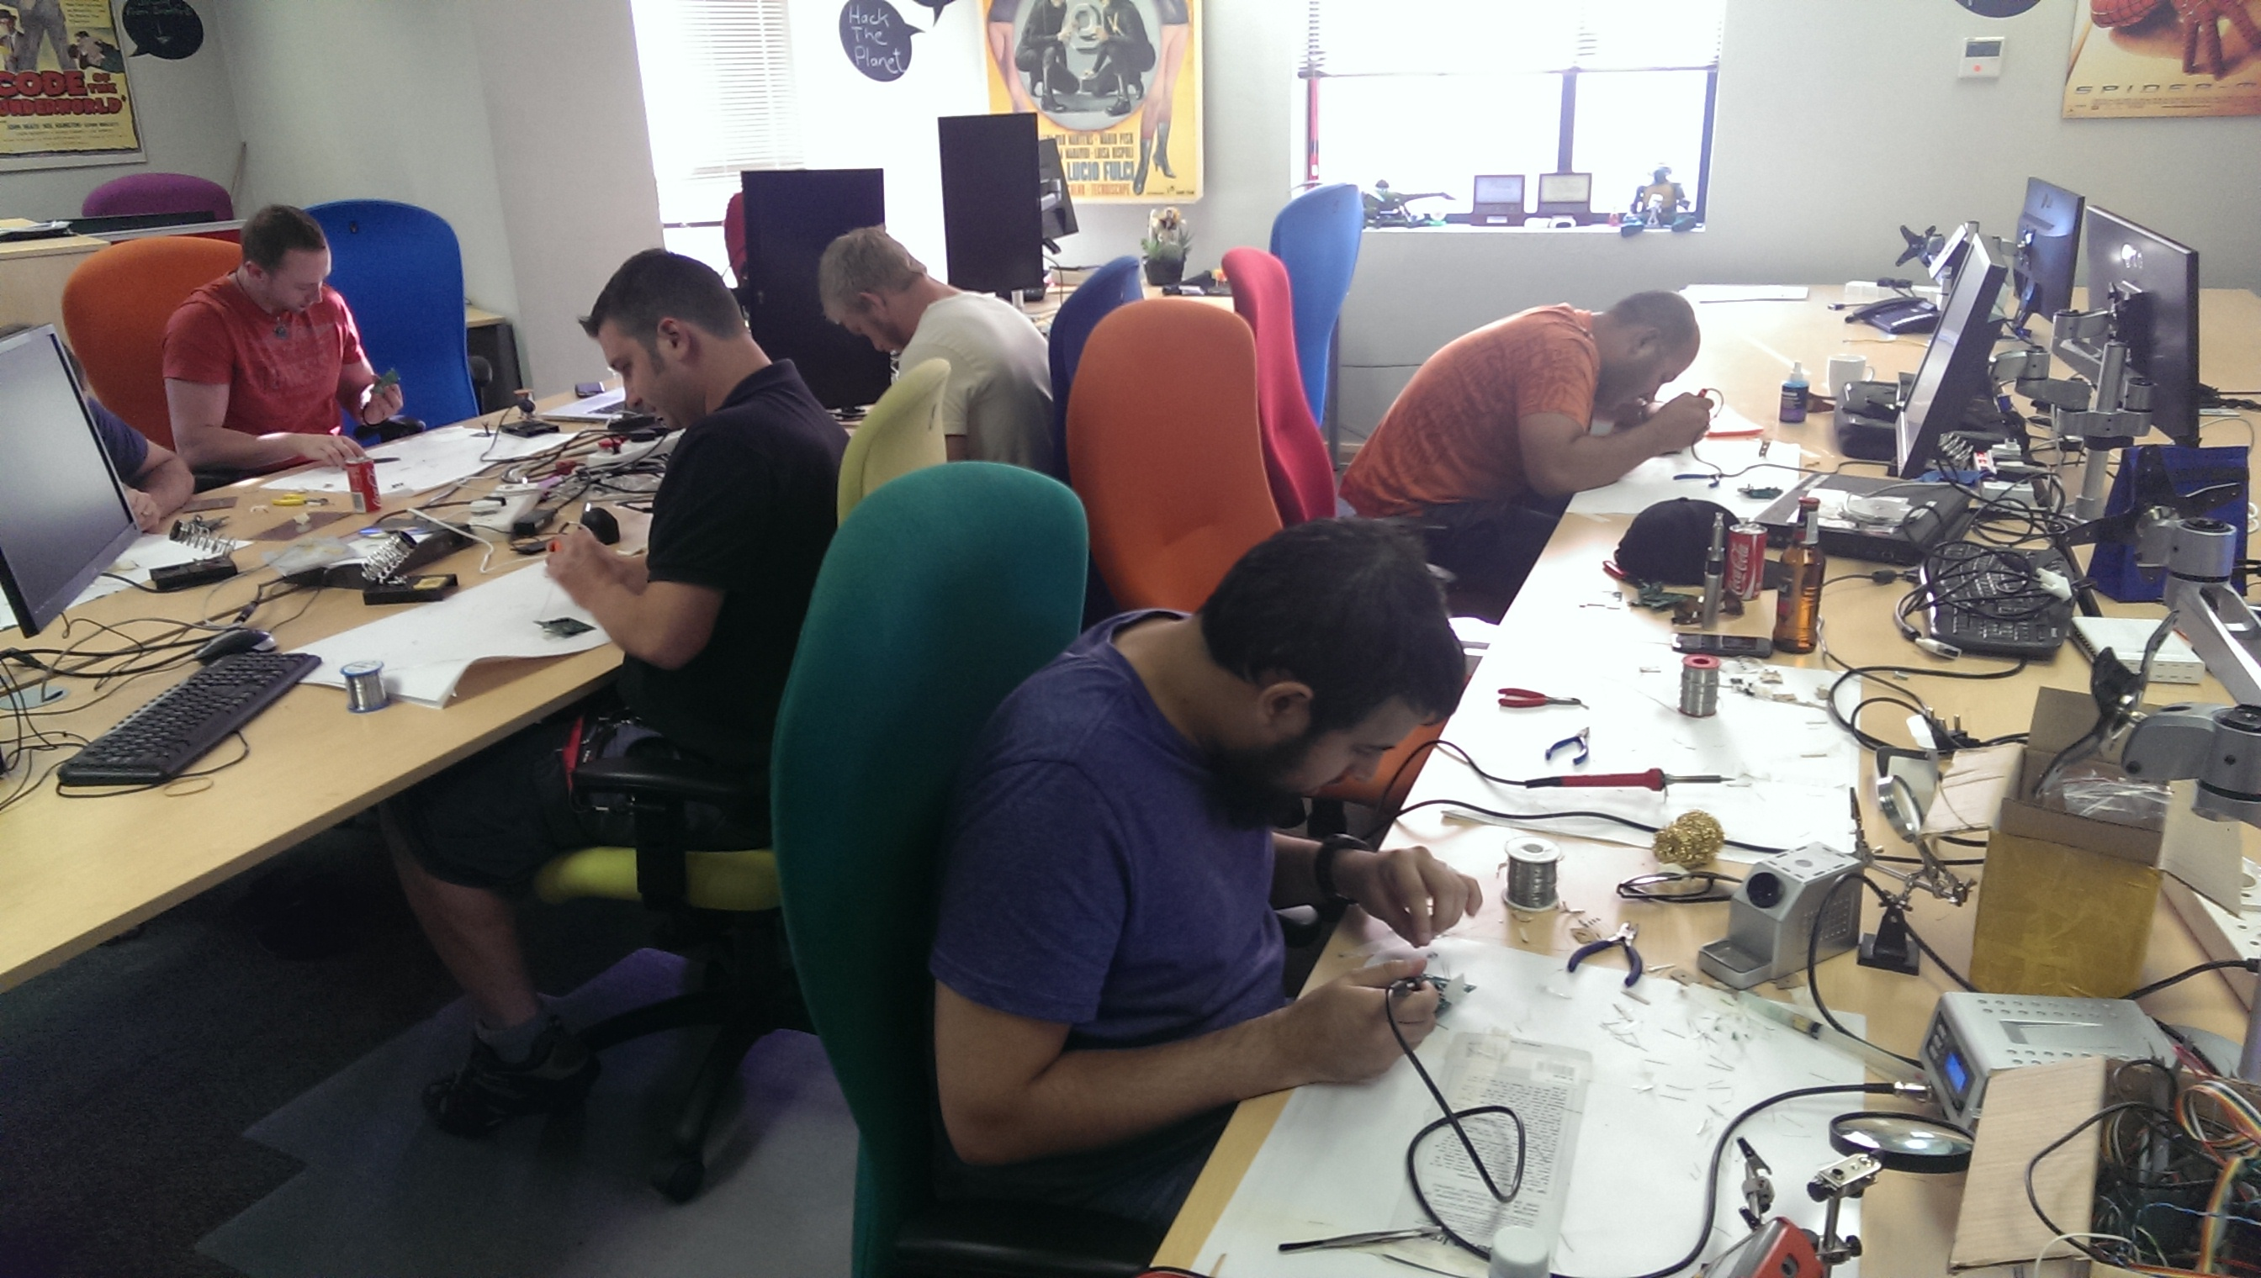
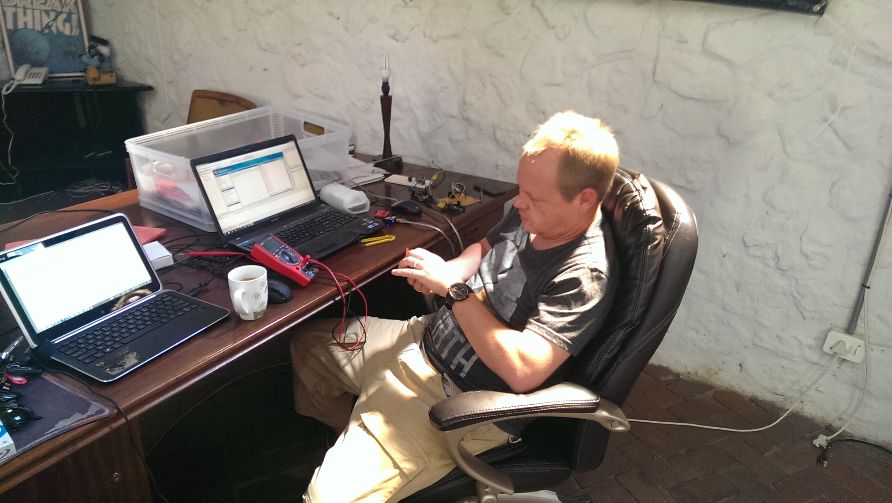
First.. Thanks!
It would never have made it off the breadboard without people@:
  Dominic White
  Haroon Meer
  Marco Slaviero
  Roelof Temmingh
Twas a secret, but both Sensepost and Thinkst (Dominic + Haroon) put $ for it...
  After being told the badges might never turn on and wont have any of their names on them
  (that’s coming back to bite them later in this talk)
Motivational Support + Coding – Jameel Haffejee
Solder team: (Keiran, Dominic, Ettiene, George, Roelof, Todor, Jameel) – Gave up a Saturday!
LCD Repair/debug/its-okay-you-can-do-this-at-work: Roelof

Slide 7
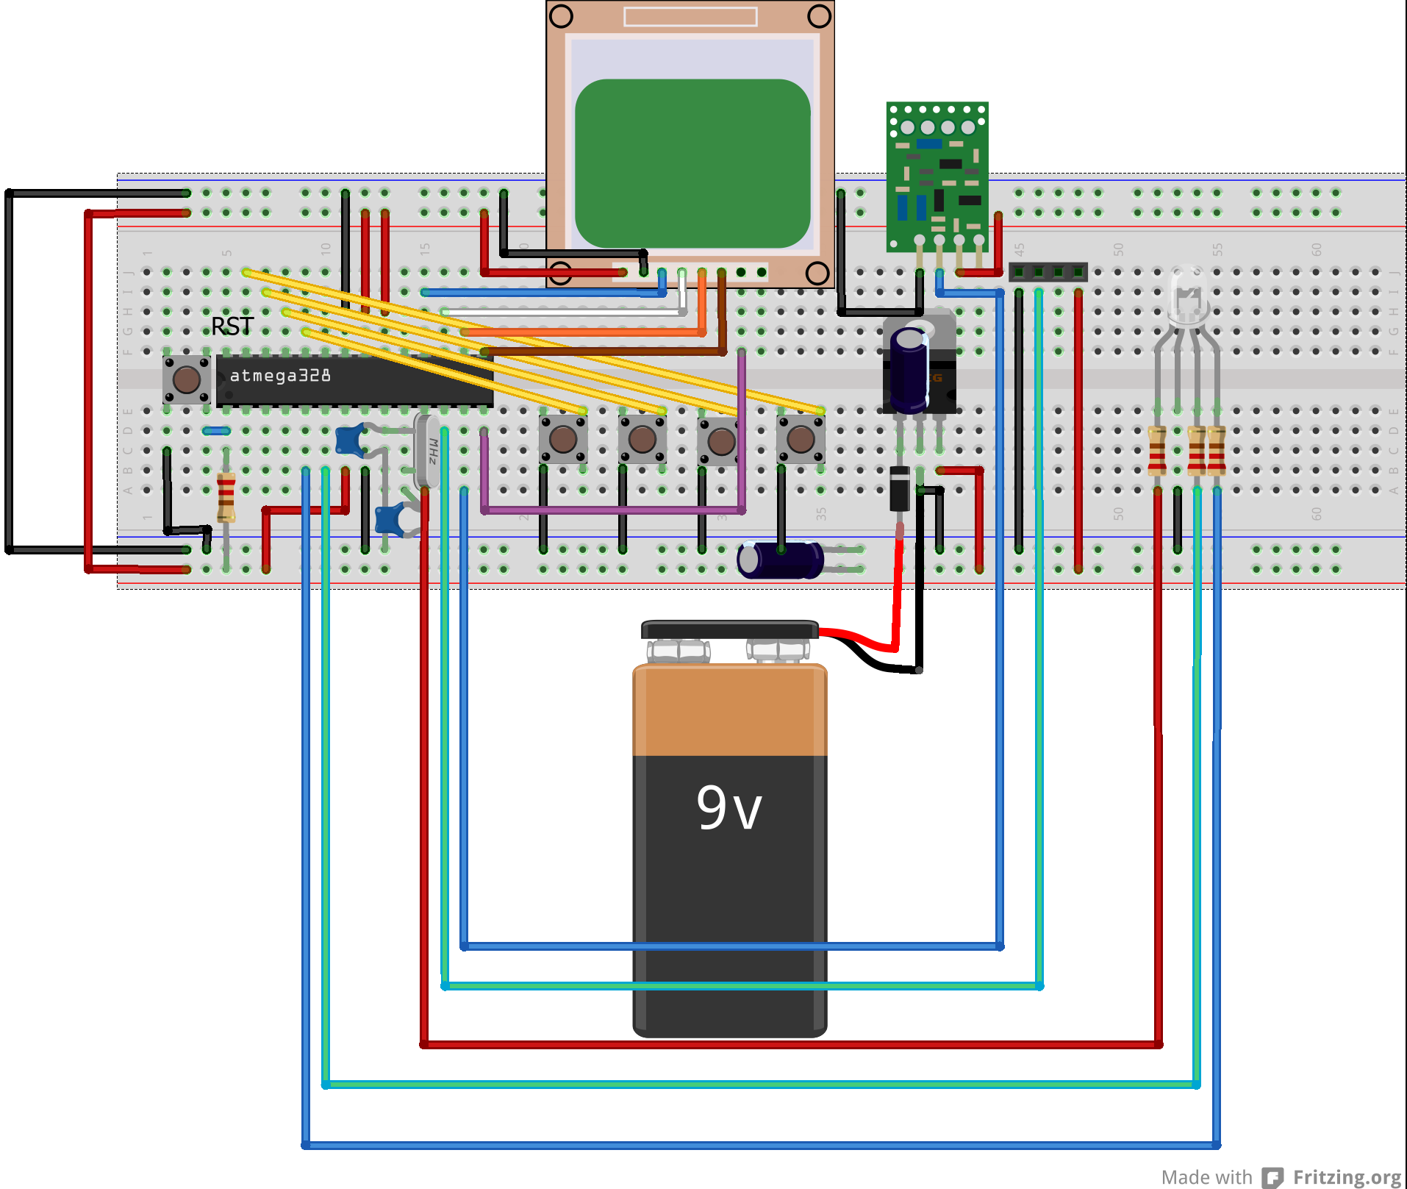
Starting point
Breadboard
433Mhz Comms (id worked with it before – see last years talk)
  Side note: Sorry about not being able to open or close your car.
GLCD (Nokia 5110)
RGB LED (look shiney colours – IT MAKES THEM ALL!)

Slide 8
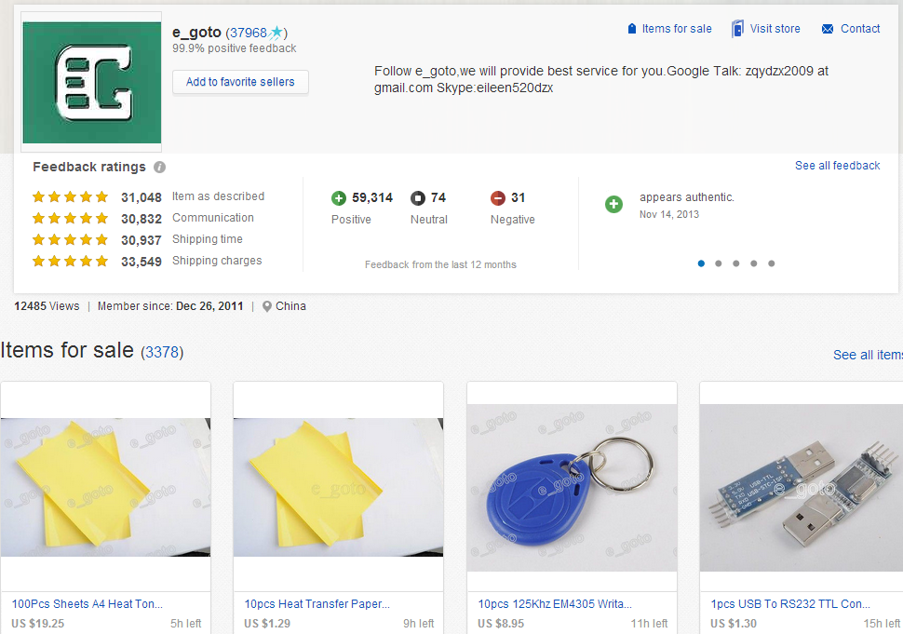
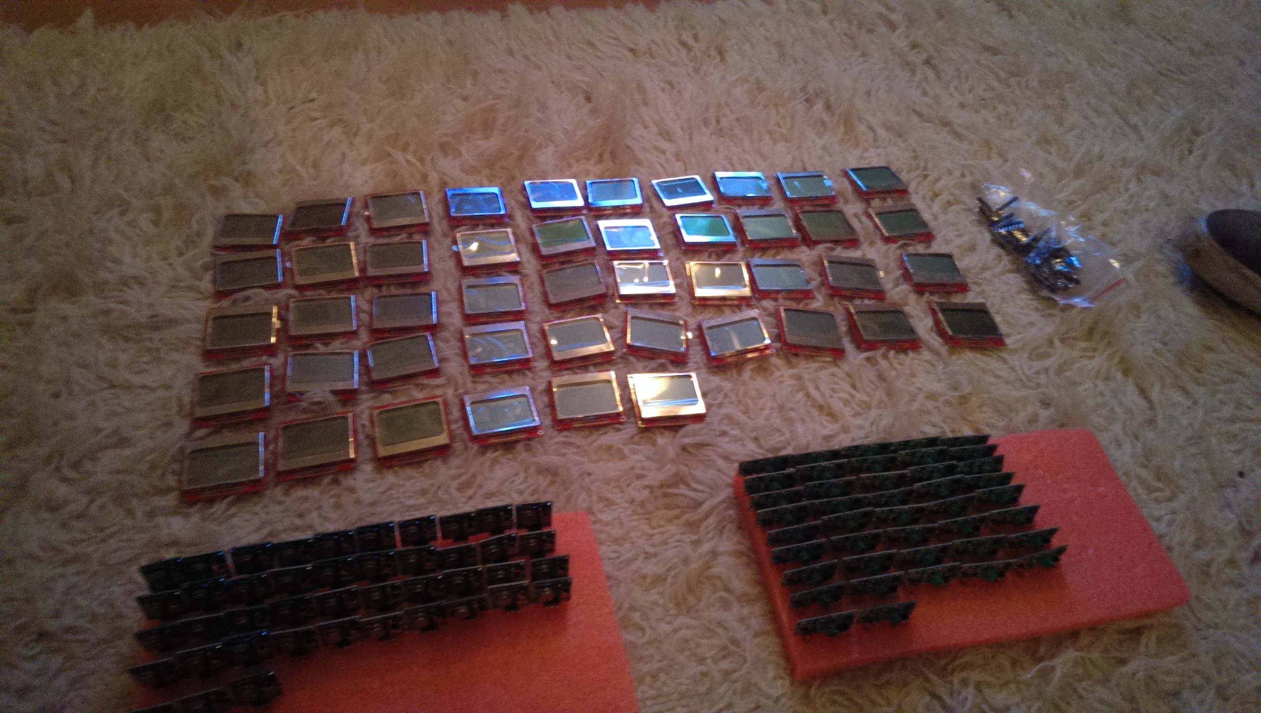
When Andrew Met China
Breadboard works well, but how much are things?
  Adam Laurie / Zac Frankens talk at DC2013 – they got it all from eBay cause its cheap
Started looking around on eBay and fell in love.
  SO MANY THINGS, SO CHEAP, SO BULK!
Enter the component love of my life – e_goto trading!
  $180 = 50x LCD + 50x RF + Skype with ‘Eileen’ constantly entertaining
  (it’s a lot of $, but I got a lot of things!)
Beside the items, buying a lot of things gives you pretty things:
  ELECTROSTATIC PLASTIC TUBING!
  FOAM FOR DAYS!

Slide 9
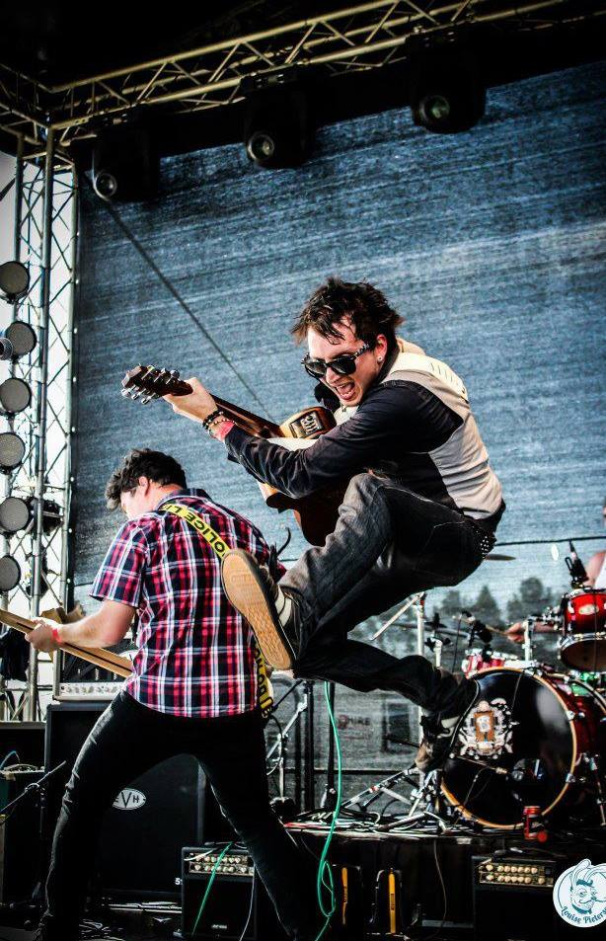
PCB Design v1
Had Components now I needed a board! Luckily I knew some engineers ->
Overly complex applications (also lazy – see prev talk)
  Just watch someone do it and try and follow!
Took most of the Arduino pins to parts of the board:
  3,4,5 – RGB LED
  6 – RF Receive
  7 – RF Transmit
  8,9,10,11,12 – LCD
  A1,A2,A3,A4 – Buttonz
Added Headers for LCDs ( more on these later)
^ Plays in a punk band,
designs PCBs.

Slide 10
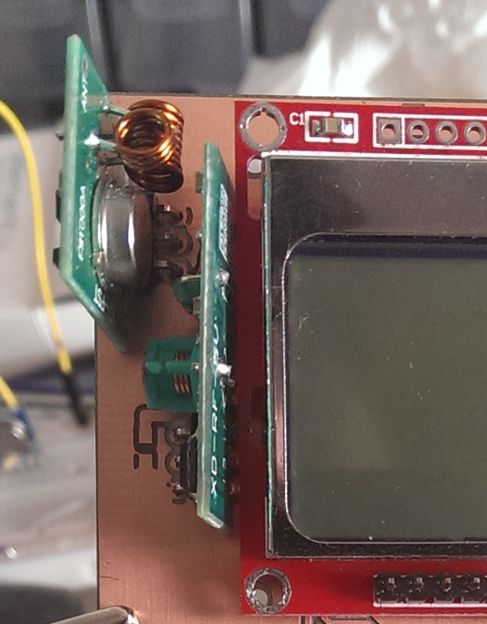
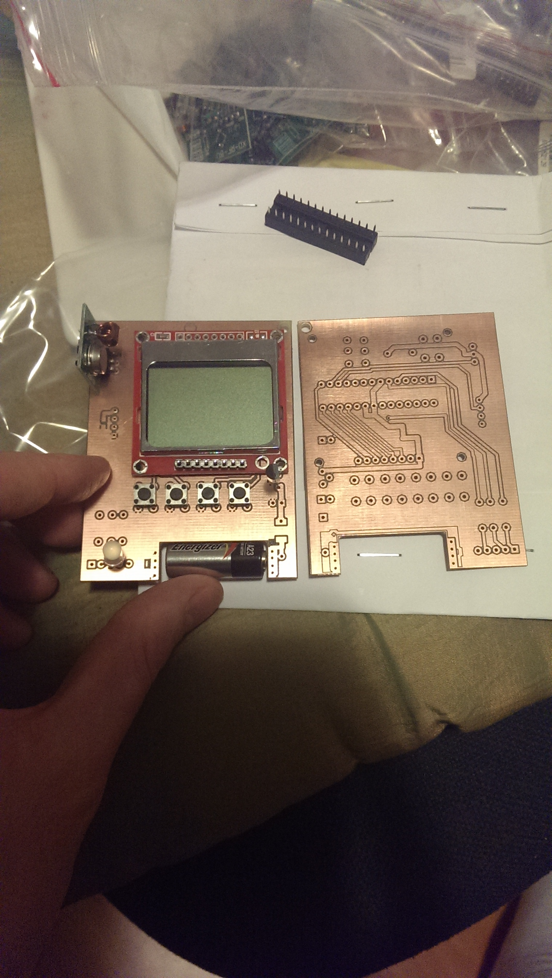
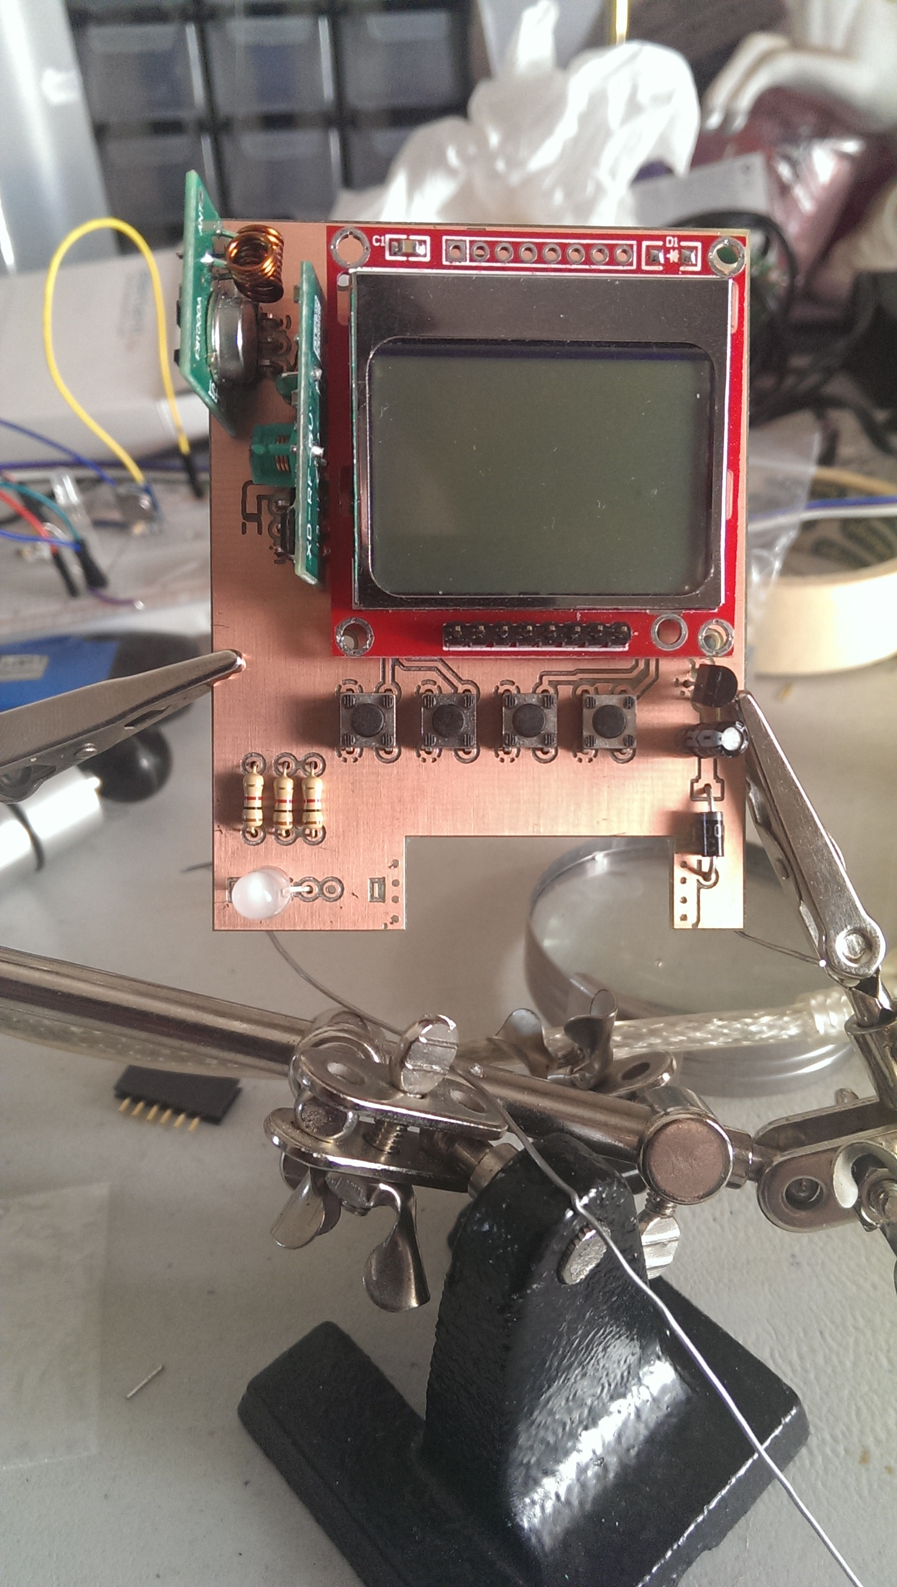
PCB Design v1: Prototype
Anonymous friends said they could do it for free!
  (Andrew loves free)
Was etched with cool machines, but no plated-through-hole
  PTH, who needs that we said
    MOST FRUSTRATING WEEKEND OF MY LIFE
RF CHIPS THE WRONG WAY ROUND!?!?!

Slide 11
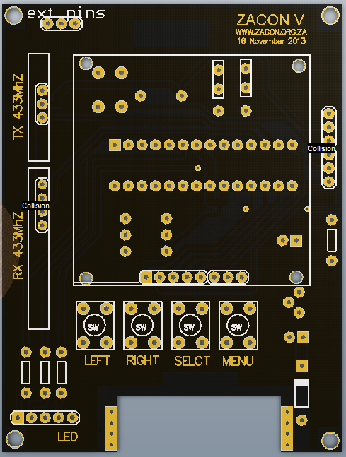
PCB Design v2
Added Additional screen for non .cn screens
Adding EXT pins
PUT THE RF CHIPS THE RIGHT WAY ROUND
Added ICSP header
Fixed the backlight issue
  DO NOT SHORT THESE ON THE BLACK BADGES
  ^SRS, stuff goes bad.

Slide 12
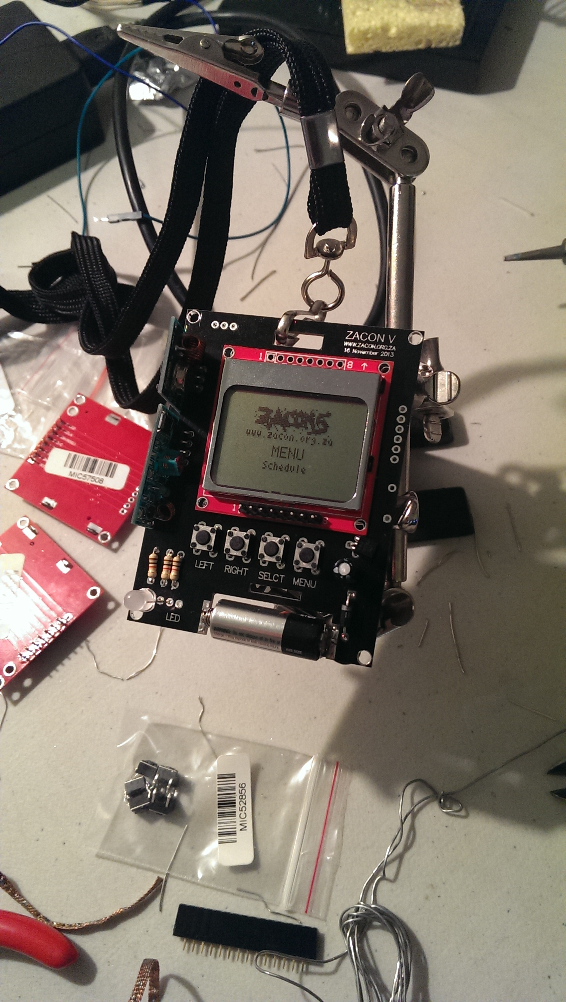
PCB Design v2: Prototype
Printed at Hackvana
  Really nice guys, have IRC, always available
  Help with design, choices etc
First ones came through really nicely and are now the black badges (was a small run)
  Not as fully featured as the red/green/white
  ^soz.

Slide 13
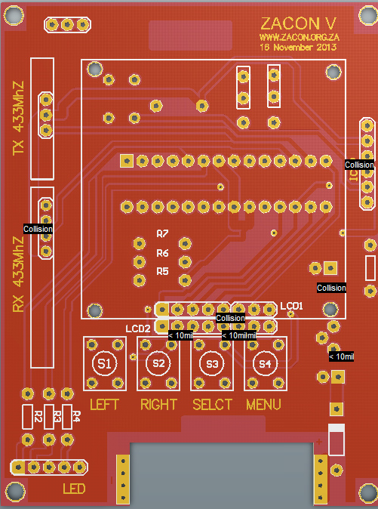
PCB Design v3
Printed at Hackvana again
Added functionality for “other” kinds of LCDs
  That wasn’t hilarious.
Silkscreen for components

Slide 14
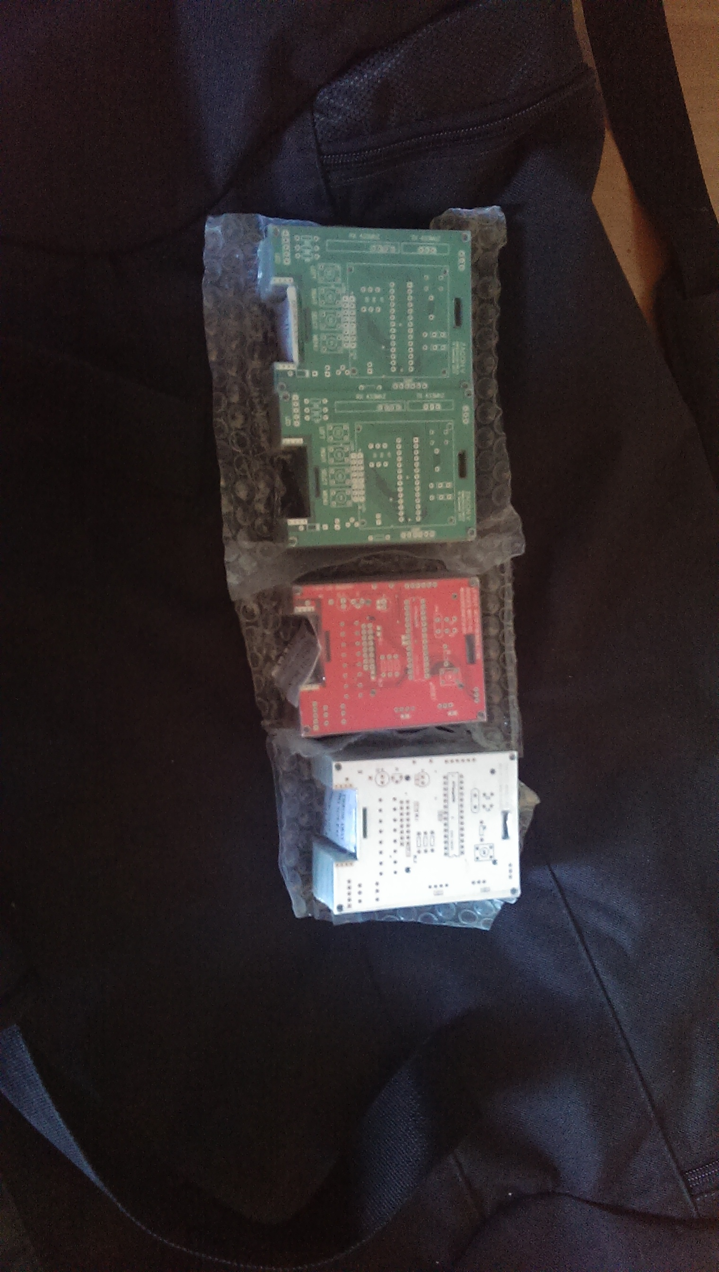
PCB Printing
Looked at prices from lots of places,
  Local is easier but a lot more expensive
  International is cheaper but customs lottery (or its incremental??)
    0% on first LCD+RF
    12% on first PCB run
    15% on second LCD+RF
    18% on final PCB run
    Stopped ordering from eBay or I know the next one would be 21%
Hackvana has friend IRC group, where they can fix stuff:
  “no diode?”, “whats a diode”
  “no caps?”
  “Are you really doing this?”

Slide 15
Overview
PCBs were sorted, stuff was arriving from china: (my gran phoned me once a week)
  RF Kits
    433Mhz Receiver (to ‘listen’)
    433Mhz Transmitter (to ‘speak’)
  GLCD
    Nokia 5110 Displays (now the bane of my existence and Roelofs fear)

Slide 16
Components
Components are all through hole (ie, push it through the hole, solder)
  Simple, like me!
RF are separate boards (green)
LCDs are separate boards (red)
4 types of badges:
  Black – Committee / BadgeGroup
  Red – Speakers / Helpers
  Green – Attendees
  White – Build-your-own-badge (not THAT BYOB – but maybe later!)

Slide 17
Main Components: LCD
Problems
  Different types (pinouts different)
  .cn LCDs REFUSE to work on some badges yet work with Arduino (you can have my black badge if you figure out why)
  LCD needs 3.3v, RF needs 5v, Arduino will take either!
  .cn LCDs are VERY heat sensitive
  (if you solder the headers on and take too long you lose a life)
Work Arounds
  I am now a speed soldering record holder
  Had to sacrifice a Badge to be a debug board
  Used resistors to take current from 5v to 3.3v
  Bought a bunch of new LCDs
    Although I still failed 4 of the 20 last night!

Slide 18
Main Components: RF
Problems
  Range can go up to 90m, luckily we bought cheap, range is about 1m
  Cannot Send and Receive at the same time
    UDP much?
  TX is blocking
    Cannot “hear” badges if it is “speaking” :<
Work Arounds
  Had to actually TUNE some to get a better range (they were doing <15cm)
    Didn’t have to ‘detune’ any – yay for cheap!
  Badges only transmit at random(1,30seconds)

Slide 19
Main Components: ATMEGA328
Wanted ATMega328P-PU,
Got ATMega328-PU,
  difference is power usage (not much) and the chip identifier
  Wasted about 8 hours before I noticed one had an extra ‘P’, FML
Chips didn’t have bootloaders on them
  Bootloaders buy you Arduino compatibility + using Serial pins (0,1,2)
  Optiloader!
    Quick flashing of optiboot, bootloader (used by modern Arduino)
    Not as reliable as it seems (had to reload ~10 bootloaders of 80 chips)
Burning application:
  ICSP – works 100% of the time, destroys bootloader, takes ~60 seconds (x80)
  Putting chips in a working Arduino – works 100% of the time, IS PAINFUL TO DO (perma bending pins)
  Putting chips in a zif circuit and attaching an Arduino without a chip – works 70% of the time but takes 5seconds to burn (some of the chips had to be configured 4 times!)

Slide 20
Main Components: ATMEGA328
Programmed with VisualMicro (Visual studio plugin for Arduino)
ATMega = 2K of memory, 1K of EEPROM, 20K of program space
2K of memory is impossible to work with, especially if you are using strings of text!
Code had to be slipstreamed a few times to beat the memory constraints
Stuff stored on badge permanently:
  Friends (seen Badges)
  Badge Number
  WHOAMI data
This talk isn’t about the code, you can look at http://github.com/AndrewMohawk/zaconv/

Slide 21
Power
This section was sadly the most disappointing
  Didn’t really consider this a problem (started with a 9v Battery that does 400-500 mah)
    I WAS WRONG.
    Smaller isn’t better (that’s what she said)
Regulator + Arduino + circuitry for Arduino = 8mA
RF = 4mA
LCD = 12 mA
Using 12V batteries, that do 40-55mah
  45 / (7+5+12) = 1.8 hours AT.BEST..
Not something that’s easy to fix, unless you have a portable battery
  Min requirements: 5v, Max: 35V
  Ie. 1800mah usb battery = 75 hours of badge!
If you want your badges to last longer than a 2 hour max, bring A23 batteries tomorrow!
SOZ. NEXT TIME ILL ADD A SWITCH (RT)

Slide 22
Soldering
ETA for a build:
  1 hour first build
  25 minutes after you have done a few
  18 minutes if you got the skillz that killz.
60+ badges = 60 * 25 = 1500 minutes = 25 hours!
Gave up a whole Saturday, buy them drinks/things!
  Dominic, Keiran, George, Ettiene, Roelof, Todor, Jameel

Slide 23
Conclusion on building badges
NEVER DO IT, ITS WAY MORE WORK THEN IT SEEMS
  Talks are a lot easier and don’t need to last more than 1.5 hours.
Learnt TONS about power, soldering, components, how not to burn yourself
Make EXTRA sure components are in the right places before soldering
  Takes 2 minutes to solder the LCD
  Takes 45 minutes to DESOLDER the LCD
  Desoldering is messy and often wrecks boards, and just no.
You get what you pay for, see screens / RF
  And sometimes that is okay.

Slide 24
Part2: How the badges work

Slide 25
Interface
4 Buttons to the world
Interface has the following:
  Intro – INNNTRRROOOO
  About – Yawn, text.
  Schedule – Shows ZaCon V schedule (left+right to go through it)
  Live Speaker – Shows the current Speaker (will be updated from machine near the stage)
  WHOAMI – Ability to view custom uploaded data
  Stats – Shows badge number, number of badges seen (“friends”) and available memory

Slide 26
“Hackability”
Idea behind the badges was to make it easy for people to mod/change/play
Badges run Arduino Bootloaders:
  Can be placed in any Arduino Uno
Badges expose pins 0,1,2 (RST,TX,RX)
  Can be programmed from separate Arduino and/or comms via Serial
Badges have ICSP headers:
  Can be programmed from ICSP Programmer / Another Arduino
We have setups to transmit to the badges, if you wanna customize yours, find us tomorrow!

Slide 27
COMMUNICATION
Everything is transmitted via AM/OOK at 433mhz
Types of transmissions:
  S<xxxx> - Badge saying “Hi I am xxxx”
  R<xxxx>:<yyyy> - Badge saying “Hi, Ive seen a relationship between xxxx and yyyy
  A<????> - Resets badge to ‘factory’ (no stored friends/relationships)
  L<zz> - Set current live speaker (this overflows if you wanna read memory - /dev/random)
  U/V/W<text> - Update the WHOAMI screen (press left to save to EEProm)
  C<????> - Cool badge mode

Slide 28
“Mesh” networking
hybrid-mesh-stuxnet-SCADA-badbios-in-the-cloud
  But not as hip.
Every badge transmits its badge number (S<xxxx>) every Random(1,30) seconds
Badges will listen for any transmits, store the data in the EEPROM (perma)
  Will ALSO store the data in a 5-big-array -
  Relationships: I know that my badge and the one I just heard are friends!
Badges will also store in that 5-big-array any OTHER relationships heard
  I know that yyyy and zzzz are friends too!
Badges will also transmit one of the random relationships seen every time they transmit their number

Slide 29
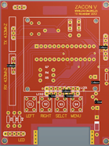
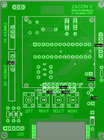
Now in pictures!
Hello, I am badge 1111
S1111
Relationships:
{?,?,?,?,?}
Badge 1111
Ooh, you sound nice, ASL?
Stores 1111 to EEPROM
Relationships:
{1111:2222,?,?,?,?}
Badge 2222

Slide 30
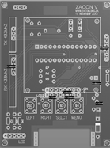
Now in pictures!
NIIIICE
Stores 2222 in EEPROM
Relationships:
{2222:1111,?,?,?,?}
Hello, I am badge 2222
Hello I know about 1111
and 2222 being friends!
Relationships:
{1111:2222,?,?,?,?}
Badge 1111
Double NIIIICE
Stores 2222 in EEPROM
Relationships:
{2222:1111,?,?,?,?}
Badge 2222
Badge 3333

Slide 31
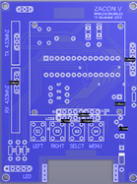
Now in pictures!
Hello, I am badge 3333
I know 2222 and 1111 are friends!
Relationships:
{2222:1111,?,?,?,?}
Neato Torpedo!
Stores 3333 in EEPROM
Relationships:
{3333:4444,2222:1111,?,?,?}
Badge 3333
Badge 4444

Slide 32
What this means
Green tells grey that red and green are friends
Red and green know each other
Grey tells blue that red and green are friends

Slide 33
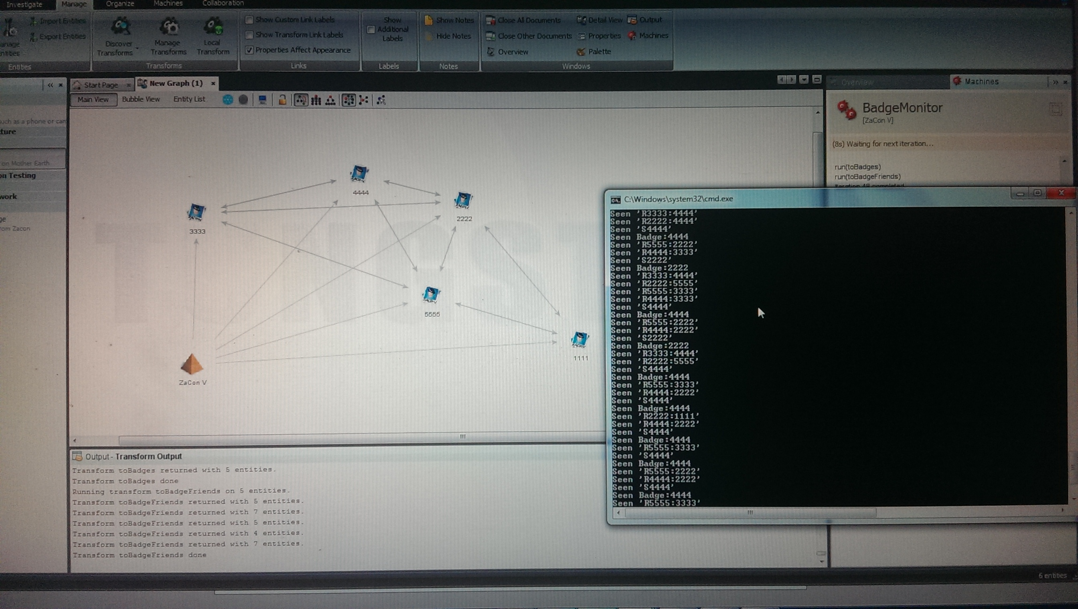
Something about a man with a hammer
Maltego demo here! (Microwave test)

Slide 34
Conclusion
Building the badges was FUN, but a LOT of work
Problems don’t scale well (incorrect sample badge for soldering!)
Everything takes more time than you anticipate
Objectives: 40 Attendee Badges, 20 Speaker Badges
Reality: 37 Attendee Badges, 17 Speaker, 23 DIY (still had leftover from my eBay craze)
Next year?
Perhaps, but not right now :)
Everyone buys their own badges – how much would you pay?
Maybe the badges could last for the whole con.

Slide 35
Thanks + BYOB
@AndrewMohawk
Andrewmohawk.com
Andrew@andrewmohawk.com
Build-your-own-badge starts in x minutes from now

